Slide 1
Spotify Top Songs Analysis
ANLY 500-51- A-2021/Fall
Arnob Chanda, Kai Mei, Hanying Chen

Slide 2
Introduction & Motivation
Due to digitization of the music label industry, vast amounts of music related data can be utilized to help companies better understand the preferences of music listeners.
Spotify is a Swedish audio streaming and media services provider founded on 23 April 2006 by Danidel Ek an Martin Lorentzon. It is the world's largest music streaming service provider, with over 381 million monthly active users, including 172 million paying subscribers, as of September 2021.
The current music recommendation analytics are more focused on the user specific metrics such as favorite singers, music genres and listening history and we believe adding the song specific metrics such as song duration, danceability, loudness, liveliness etc. can help Spotify improve its recommendation model.
Our study is to provide a music specific metrics focused complementary popularity prediction model to mitigate the limitations of user specific metrics focused model.

Slide 3
Related Work
The main idea of a project like this is to predict the popularity of something based on some known metrics.
In general, a basic recommendation system is the basis for maintaining user retention which allows a company to make their platform more user-friendly and in turn generate more revenue.
For example, in the case of Netflix, by using the known variables of a movie or a series, the popularity of it can be estimated. Those movies or series would then be recommended and if the person watches the recommended movie or series, the model is successful.
Companies like Facebook can (and have) use known viewing patterns of a user correlate it with the known metrics of an ad and then using that can target a specific ad or piece of information towards them.
Also in cases of advertising companies or agencies, models like these can be used to target a specific ad or a piece of information towards a person or a group of people.

Slide 4
Overview
Data
Exploratory data analysis
Methods
Results and evaluation
Future work

Slide 5
Data
Original dataset has 15 columns with 603 observations.
Each observation has the following:
Title - Name of the song
Artist - Creator of the song
Genre - Genre of the song
Year - Release year of the song
Bpm - The average beats per minutes of the song
Energy - The energy of the song (Range 0 - 100. The more the value, the more energy of the song)
Dance - The danceability of the song (Range 0 - 100. The more the value, the easier it is to dance to the song)
Db - The loudness of the song
Live - The liveness of the song (Range 0 - 100. The more the value, the more likely song is a live recording)
Val - The positive mood for the song (Range 0 - 100. The more the value, the more more positive mood for the song)
Dur - The length of the song
Acoustic - The accousticness of the song (Range 0 - 100. The more the value, the more acoustic of a song)
Speech - The speechiness of the song (Range 0 - 100. The more the value, the more spoken words in the song)
Pop - The popularity of the song (Range 0 - 100. The more the value, the more popular the song)

Slide 6
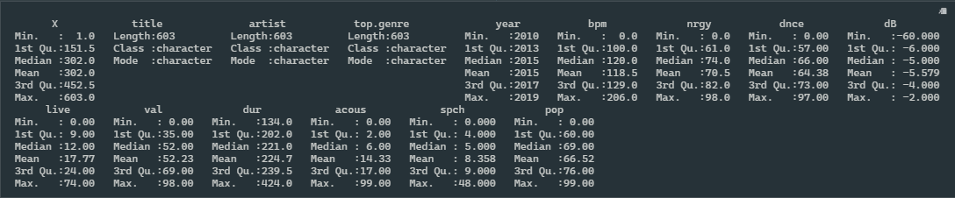
Data summary
Below is the summary of the original dataset.

Slide 7
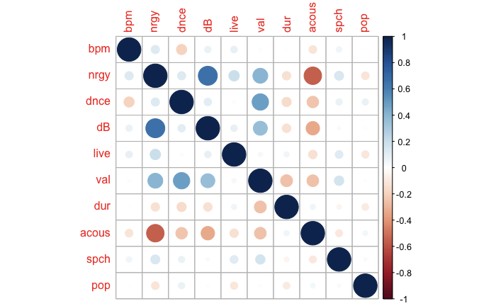
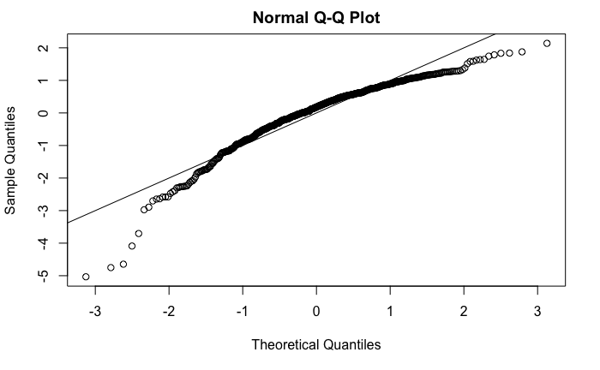
Exploratory Data Analysis
dB and nrgy are positively correlated with Pearson correlation=0.6434
Correlation plot
Data Preprocessing
Accuracy
Outliers
Missing Values
Checking Assumptions
Additivity
Linearity
Normality
Homogeneity and Homoscedasticity
QQ plot with light tails on both ends

Slide 8
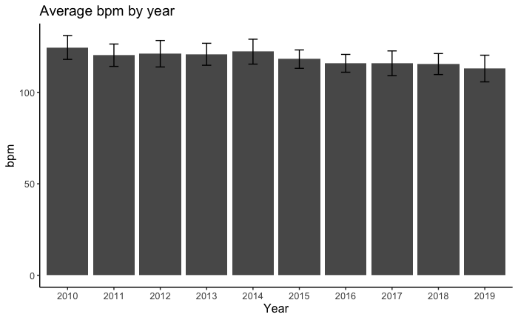
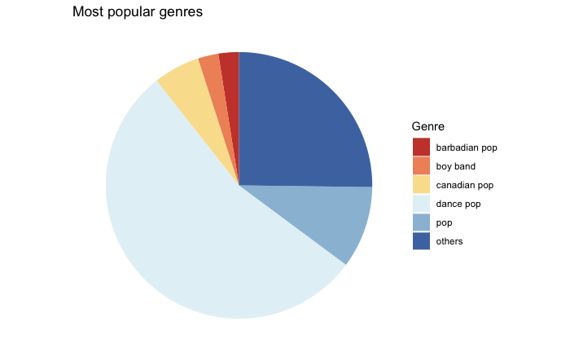
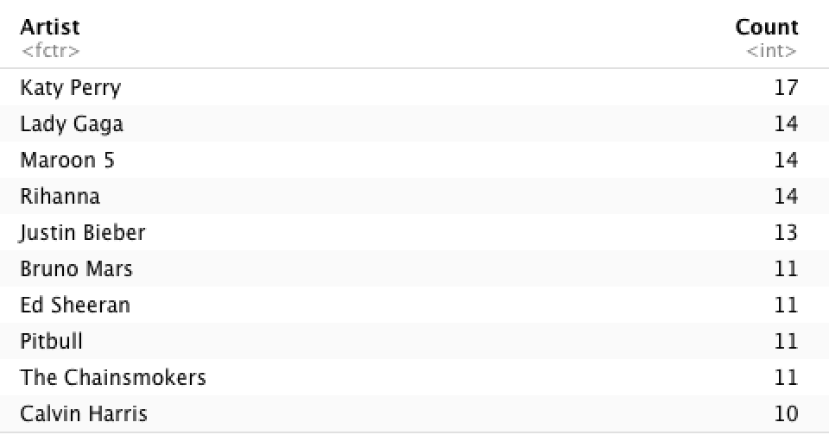
Exploratory Data Analysis
Visualization and insights
Average bpm over time is decreasing slightly
The most popular music genre is dance pop
Top 3 popular artists from 2010 to 2019 are Katy Perry, Lady Gaga and Maroon 5

Slide 9
Methods
We chose multiple linear regression to build the forecast model and pop score is our dependent variable.
Three stages: 1. run the pop score against all other numerical variables to build a full model; 2. run pop score against nrgy, live, dur, dnce, and acous, which were shown as highly correlated with pop score in our exploratory data analysis; 3. built a stepwise regression model based on both backward and forward selection.
Stepwise regression is a method of fitting regression models in which the choice of predictive variables is carried out by an automatic procedure. In each step, a variable is considered for addition to or subtraction from the set of explanatory variables based on the form of a forward, backward, or combined sequence of F-tests or t-tests. In our analysis, we used both directions.
Algorithm: The ‘lm’ function was used in the first two steps. Then we installed the ‘leap’ and ‘MASS’ packages and used the ‘stepAIC’ function from the packages to build a stepwise regression model.
Evaluation: we used both R² and root mean square error (RMSE) as our model evaluation metrics. RMSE is the standard deviation of the residuals, and it tells how concentrated the data is around the line of best fit.

Slide 10
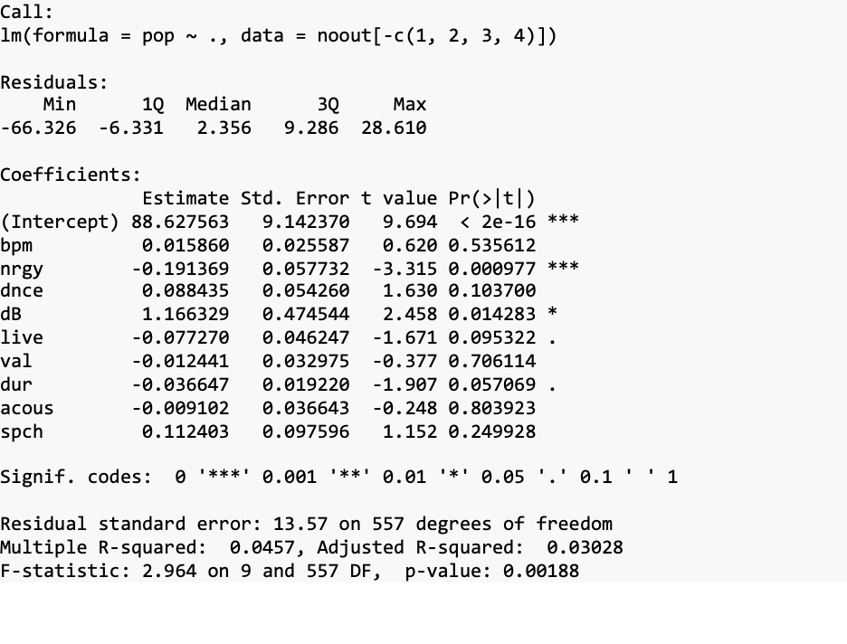
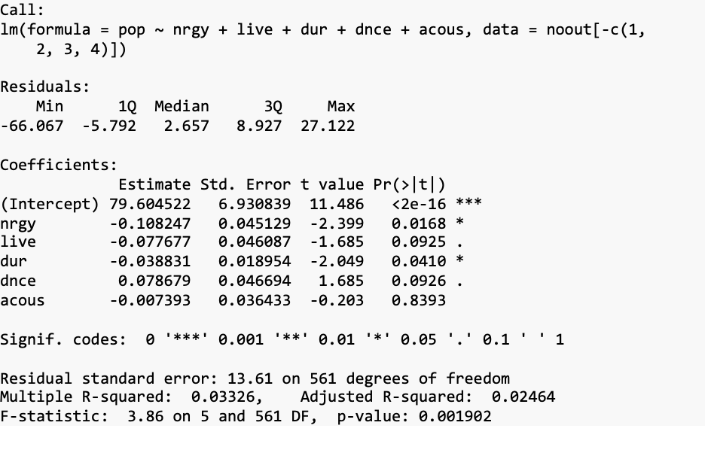
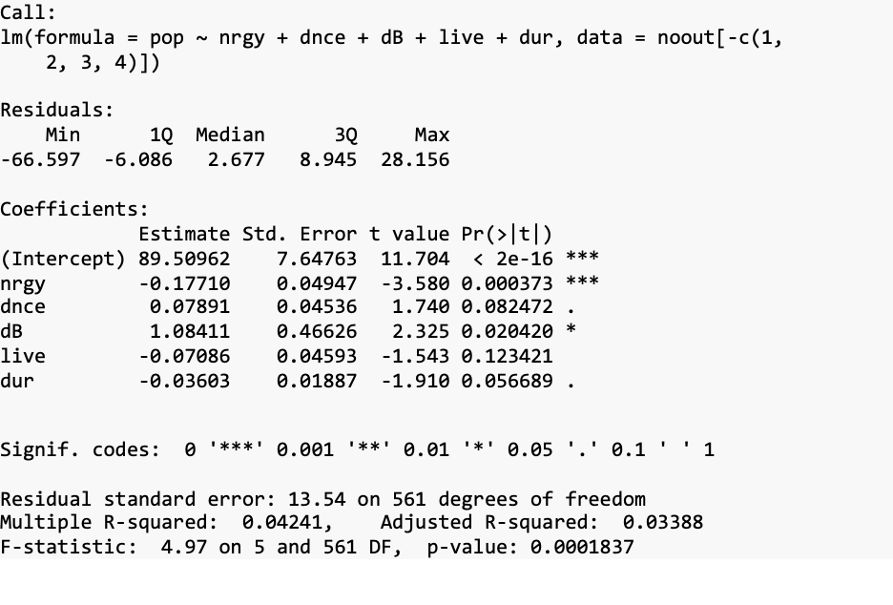
Model Results and Evaluation
Full model has the lowest RMSE; Stepwise model has the highest adjusted R²
Model 1: Full Model
Model 2: High Correlation Model
Model 3: Stepwise Model
R²: 0.0457
Adjusted R²: 0.03028
RMSE: 13.16876
R²: 0.03326
Adjusted R²: 0.02464
RMSE: 13.37352
R²: 0.04241
Adjusted R²: 0.03388
RMSE: 13.21132

Slide 11
Challenges & Lessons Learned
Challenges
Our original selected topic turns out to be out of the scope of this course, so we had to change the topic in the mid of semester
R² of our models is quite low
Lessons Learned
Communicate with the professor more to make sure the project is within the reasonable scope
Sometimes the model can only explain a small portion of the variance in the dependent variable
More data and predictors would be needed when the model is weak

Slide 12
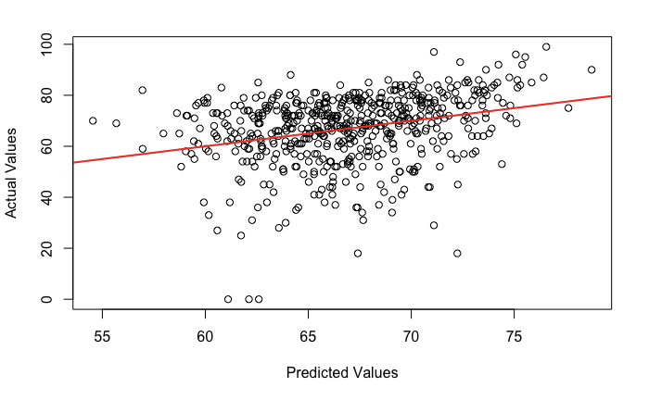
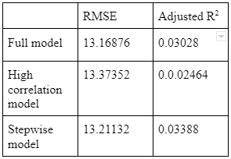
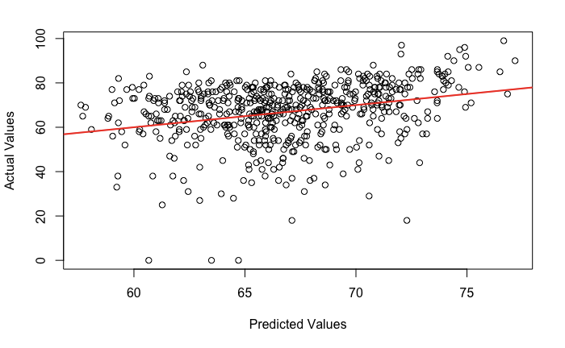
Summary
Below is our model summary:
We can see that the full model has the lowest RMSE while the stepwise model has the highest adjusted R²
Predicted vs. Actua (full model)
Predicted vs. Actual (stepwise model)

Slide 13
Future Work
Currently, we observed some degrees of skewness in variables including pop and dB. This can be remediated using non-linear transformations like log transformation.
Split the dataset into training and testing sets, so that the model can be assessed using the unseen data.
Collect more data. So far, we only have less than 600 data points to train the model. If we can gather more data from Spotify, the model would be more significant and predictive.
Add categorical variable genre into the model. This can be done by applying clustering techniques (e.g KNN) to group the minor genres into major ones.
More advanced machine learning models can be applied to achieve better accuracy. Models such as polynomial regression, generalized linear model, random forest and xgboost are all good candidates.
Analyze Spotify user comments for each song using NLP techniques. We can potentially create word embeddings using user reviews/reactions and train the model with it.

Slide 14
Next Step
We have summarized our findings in word format and the doc can be accessed here.
This slide and the report will both be uploaded to Canvas.

